Slide 1
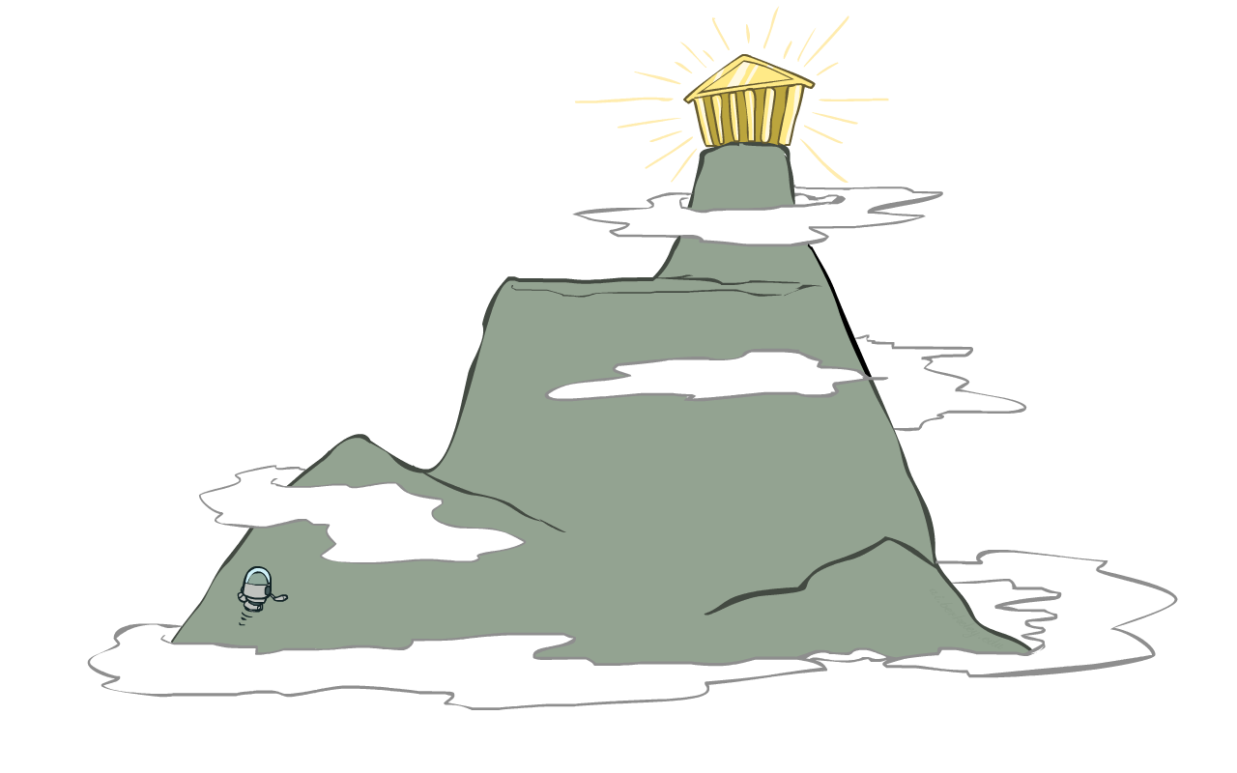
Artificial Intelligence
Constraint Satisfaction Problems (Part 2)
CS 444 – Spring 2021
Dr. Kevin Molloy
Department of Computer Science
James Madison University
Much of this lecture is taken from
Dan Klein and Pieter Abbeel AI class at UC Berkeley

Slide 2
Today
Review of A* Heuristics for PA 1
Continue with Constraint Satisfaction problems
Arc consistency AC-3 examples
Problem Structure
Min conflicts
Figure from Berkley AI

Slide 3
Learning Objectives
Apply the AC-3 to maintain arc consistency (MAC)
Investigate the problem structure of CSPs for identify more efficient solutions using cutset conditioning and tree decomposition
Apply min-conflicts algorithm and by able to code it to solve CSPs. Characterize the min-conflicts algorithm (runtime, completeness, etc).
Figure from Berkley AI

Slide 4
Student Heuristic Presentation
Alex Marasco – Finding/visit all the corners heuristics
Garrett Christian -- Eat all the dots heuristic
Figure from Berkley AI

Slide 5


CSP problems
CSPs:
Variables
Domains
Constraints
Implicit (provide code to compute)
Explicit (provide a list of the legal tuples)
Types:
Unary (one variable)
Binary (two variables)
N-ary (n variables)
Goals:
In this class: find any solution
Also: find all, find best, etc.
Figure from Berkley AI

Slide 6
Backtracking Search
Figure from Berkley AI

Slide 7
Backtracking Example
Figure from Berkley AI

Slide 8
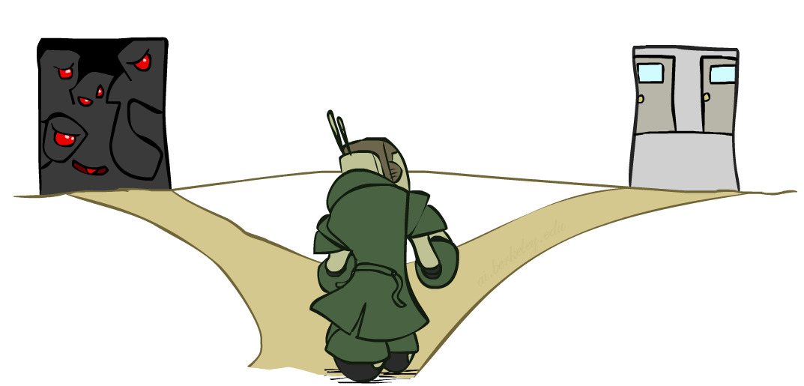

Improving Backtracking
General-purpose ideas give huge gains in speed
… but it’s all still NP-hard
Filtering: Can we detect inevitable failure early?
Ordering:
Which variable should be assigned next? (MRV)
In what order should its values be tried? (LCV)
Structure: Can we exploit the problem structure?
Figure from Berkley AI

Slide 9

Consistency of a Single Arc
An arc X → Y is consistent iff for every x in the tail there is some y in the head which could be assigned without violating a constraint
Forward checking: Enforcing consistency of arcs pointing to each new assignment
NT
Q
WA
SA
NSW
V
Delete from the tail!
Figure from Berkley AI

Slide 10
Arc Consistency of an Entire CSP
A simple form of propagation makes sure all arcs are consistent:
Important: If X loses a value, neighbors of X need to be rechecked!
Arc consistency detects failure earlier than forward checking
Can be run as a preprocessor or after each assignment
What’s the downside of enforcing arc consistency?
NT
Q
WA
SA
NSW
V
Remember: Delete from the tail!
Figure from Berkley AI

Slide 11
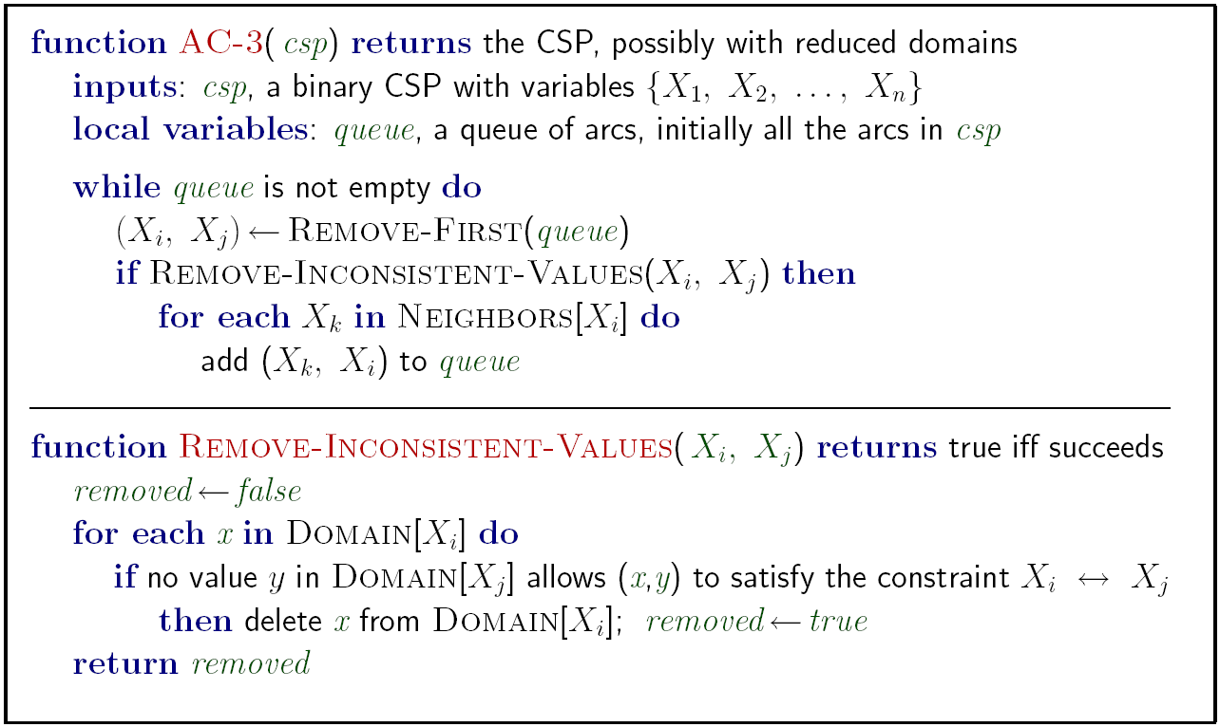
Enforcing Arc Consistency in a CSP
Runtime: O(n²d³), can be reduced to O(n²d²)
… but detecting all possible future problems is NP-hard – why?
Figure from Berkley AI

Slide 12
Limitations of Arc Consistency
After enforcing arc consistency:
Can have one solution left
Can have multiple solutions left
Can have no solutions left (and not know it)
Arc consistency still runs inside a backtracking search!
What went wrong here?
Figure from Berkley AI

Slide 13
K-Consistency
Increasing degrees of consistency
1-Consistency (Node Consistency): Each single node’s domain has a value which meets that node’s unary constraints
2-Consistency (Arc Consistency): For each pair of nodes, any consistent assignment to one can be extended to the other
K-Consistency: For each k nodes, any consistent assignment to k-1 can be extended to the k^{th} node.
Higher k more expensive to compute
(You need to know the k=2 case: arc consistency)
Figure from Berkley AI

Slide 14
Strong K-Consistency
Strong k-consistency: also k-1, k-2, … 1 consistent
Claim: strong n-consistency means we can solve without backtracking!
Why?
Choose any assignment to any variable
Choose a new variable
By 2-consistency, there is a choice consistent with the first
Choose a new variable
By 3-consistency, there is a choice consistent with the first 2
…
Lots of middle ground between arc consistency and n-consistency! (e.g. k=3, called path consistency)
Figure from Berkley AI
Notes:
Demo:
CS188 javascript demos -> source -> exercises -> csps -> CSPs demos -> CSPs demos.html
Settings:
Graph = Complex
Algorithm = Backtracking
Ordering = MRV

Slide 15

Intelligent Backtracking
Variable assignment order: {Q, NSW, V, T, SA, WA, NT}
Partial Assignment: {Q = red, NSW=green, V=blue, T=red}
NT
Q
WA
SA
NSW
What does normal backtracking do when it tries to assignment SA a color?
V
T
Figure from Berkley AI

Slide 16
Intelligent Backtracking
Variable assignment order: {Q, NSW, V, T, SA, WA, NT}
Partial Assignment: {Q = red, NSW=green, V=blue, T=red}
NT
Q
WA
SA
What does normal backtracking do when it tries to assignment SA a color?
NSW
It tries all 3 colors. None of these work. So backtrack
Change the color of T and try SA again
Still no assignment works for SA. So backtrack.
Etc.
V
T
How can we make this better?
Figure from Berkley AI

Slide 17
Intelligent Backtracking – Back jumping
Variable assignment order: {Q, NSW, V, T, SA, WA, NT}
Partial Assignment: {Q = red, NSW=green, V=blue, T=red}
NT
Q
WA
Idea: Jump to a variable that is causing a problem.
SA
NSW
Define a conflict set, which is built as we evaluate a variable. So, for SA, we check:
Can't use red, Q is added to the conflict set for SA.
Can't use green, NSW is added to the conflict set for SA.
Can't use blue, V is added to the conflict set for SA.
V
T
Backtrack to at least one of these variables so we have a chance of correcting the issue.
https://inst.eecs.berkeley.edu/~cs188/fa19/assets/demos/csp/csp_demos.html
Figure from Berkley AI

Slide 18
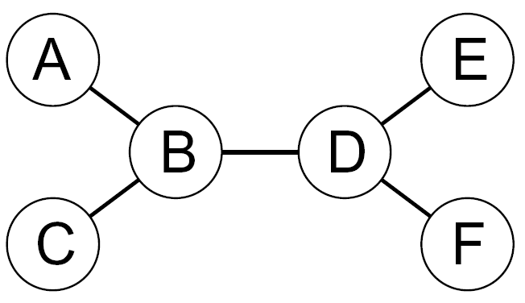
Tree-Structured CSPs
Theorem: if the constraint graph has no loops, the CSP can be solved in O(n d²) time
Compare to general CSPs, where worst-case time is O(d^{n})
This property also applies to probabilistic reasoning (later): an example of the relation between syntactic restrictions and the complexity of reasoning
Figure from Berkley AI

Slide 19
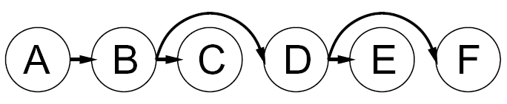


Tree-Structured CSPs
Algorithm for tree-structured CSPs:
Order: Choose a root variable, order variables so that parents precede children
Remove backward: For i = n : 2, apply RemoveInconsistent(Parent(X_{i}),X_{i})
Assign forward: For i = 1 : n, assign X_{i} consistently with Parent(X_{i})
Runtime: O(n d²) (why?)
Figure from Berkley AI

Slide 20
Tree-Structured CSPs
Claim 1: After backward pass, all root-to-leaf arcs are consistent
Proof: Each X→Y was made consistent at one point and Y’s domain could not have been reduced thereafter (because Y’s children were processed before Y)
Claim 2: If root-to-leaf arcs are consistent, forward assignment will not backtrack
Proof: Induction on position
Why doesn’t this algorithm work with cycles in the constraint graph?
Note: we’ll see this basic idea again with Bayes’ nets
Figure from Berkley AI

Slide 21
Nearly Tree-Structured CSPs
Conditioning: instantiate a variable, prune its neighbors' domains
Cutset conditioning: instantiate (in all ways) a set of variables such that the remaining constraint graph is a tree
Cutset size c gives runtime O( (d^{c}) (n-c) d² ), very fast for small c
Figure from Berkley AI

Slide 22
Cutset Conditioning
Choose a cutset
SA
Instantiate the cutset (all possible ways)
SA
SA
SA
Compute residual CSP for each assignment
Solve the residual CSPs (tree structured)
Figure from Berkley AI

Slide 23
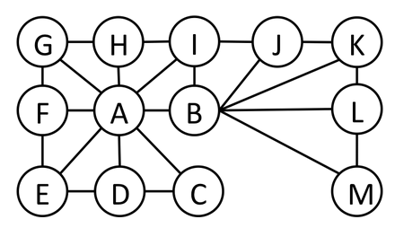
Cutset Quiz
Find the smallest cutset for the graph below.
Figure from Berkley AI

Slide 24
Tree Decomposition
Idea: create a tree-structured graph of mega-variables
Each mega-variable encodes part of the original CSP
Subproblems overlap to ensure consistent solutions
M1
M2
M3
M4
WA
≠
NT
NT
≠
Q
Q
≠
NSW
NSW
≠
V
≠
≠
≠
≠
≠
≠
≠
≠
SA
SA
SA
SA
Agree on shared vars
Agree on shared vars
Agree on shared vars
{(WA=r,SA=g,NT=b),
(WA=b,SA=r,NT=g),
…}
{(NT=r,SA=g,Q=b),
(NT=b,SA=g,Q=r),
…}
Agree: (M1,M2) ∈
{((WA=g,SA=g,NT=g), (NT=g,SA=g,Q=g)), …}
Figure from Berkley AI

Slide 25
Iterative Algorithms for CSPs
Local search methods typically work with “complete” states, i.e., all variables assigned
To apply to CSPs:
Take an assignment with unsatisfied constraints
Operators reassign variable values
No fringe! Live on the edge.
Algorithm:
While not solved:
Variable selection: randomly select any conflicted variable
Value selection: min-conflicts heuristic:
Choose a value that violates the fewest constraints
I.e., hill climb with h(n) = total number of violated constraints
Figure from Berkley AI

Slide 26
Performance of Different CSP Algorithms
Problem | Backtracking | BT+MRV | Forward Checking | FC+MRV | Min-Conflicts
USA (4 color) | (> 1,000,000)
n-Queens | (> 40,000,000)
Figure from Berkley AI

Slide 27
Performance of Different CSP Algorithms
Problem | Backtracking | BT+MRV | Forward Checking | FC+MRV | Min-Conflicts
USA (4 color) | (> 1,000,000) | (> 1,000,000)
n-Queens | (> 40,000,000) | 13,500,000
Figure from Berkley AI

Slide 28
Performance of Different CSP Algorithms
Problem | Backtracking | BT+MRV | Forward Checking | FC+MRV | Min-Conflicts
USA (4 color) | (> 1,000,000) | (> 1,000,000) | 2,000
n-Queens | (> 40,000,000) | 13,500,000 | (> 40,000,000)
Figure from Berkley AI

Slide 29
Performance of Different CSP Algorithms
Problem | Backtracking | BT+MRV | Forward Checking | FC+MRV | Min-Conflicts
USA (4 color) | (> 1,000,000) | (> 1,000,000) | 2,000 | 60
n-Queens | (> 40,000,000) | 13,500,000 | (> 40,000,000) | 817,000
Figure from Berkley AI

Slide 30
Performance of Different CSP Algorithms
Problem | Backtracking | BT+MRV | Forward Checking | FC+MRV | Min-Conflicts
USA (4 color) | (> 1,000,000) | (> 1,000,000) | 2,000 | 60 | 64
n-Queens | (> 40,000,000) | 13,500,000 | (> 40,000,000) | 817,000 | 4,000
Figure from Berkley AI

Slide 31
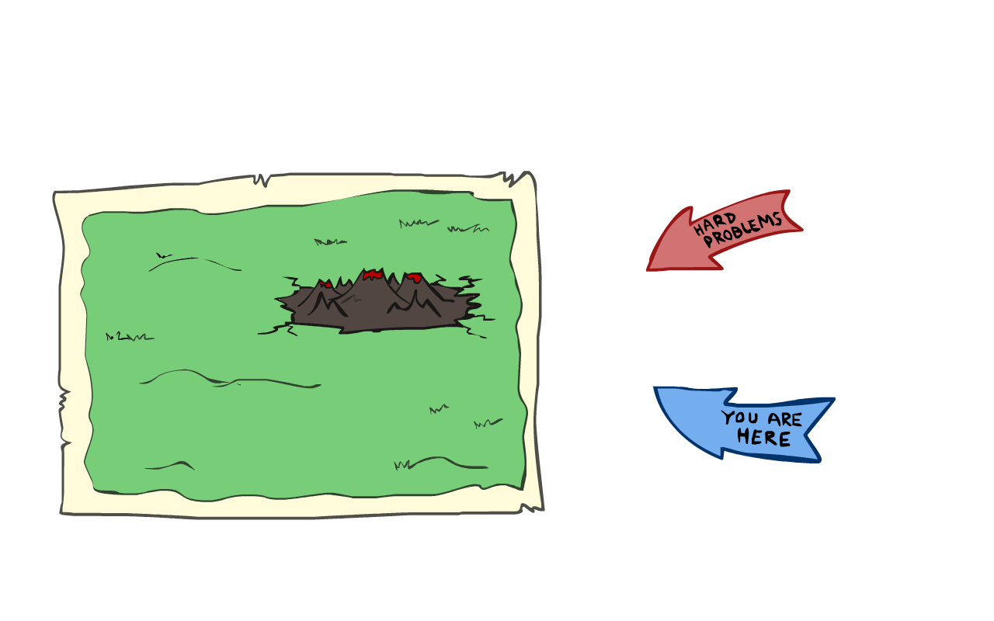
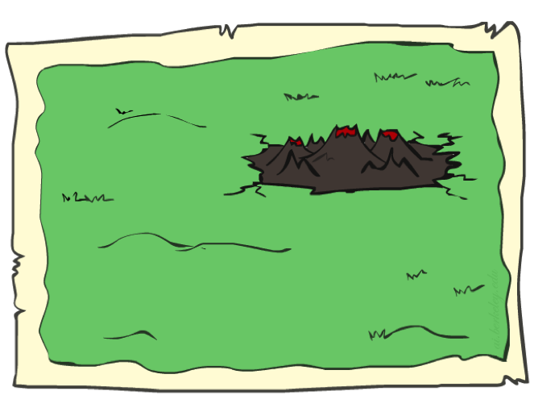
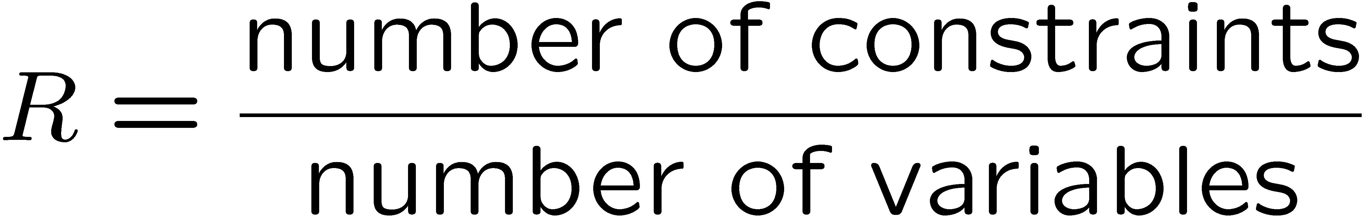
Don't Make Things too Complicated
Given random initial state, can solve n-queens in almost constant time for arbitrary n with high probability (e.g., n = 10,000,000)!
The same appears to be true for any randomly-generated CSP except in a narrow range of the ratio
Figure from Berkley AI

Slide 32
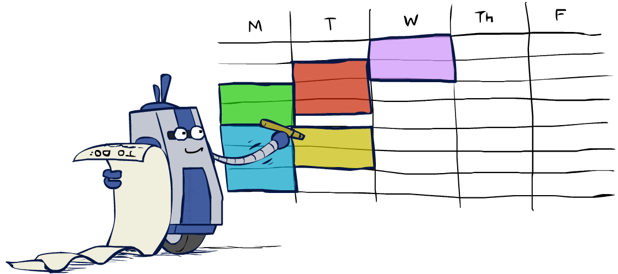
CSP Summary
CSPs are a special kind of search problem:
States are partial assignments
Goal test defined by constraints
Basic solution: backtracking search
Speed-ups:
Ordering
Filtering
Structure
Iterative min-conflicts is often effective in practice
Figure from Berkley AI

